Slide 1
Scalable Assessment of Linkage Risks
Mary Scott
16th August 2019

Slide 2
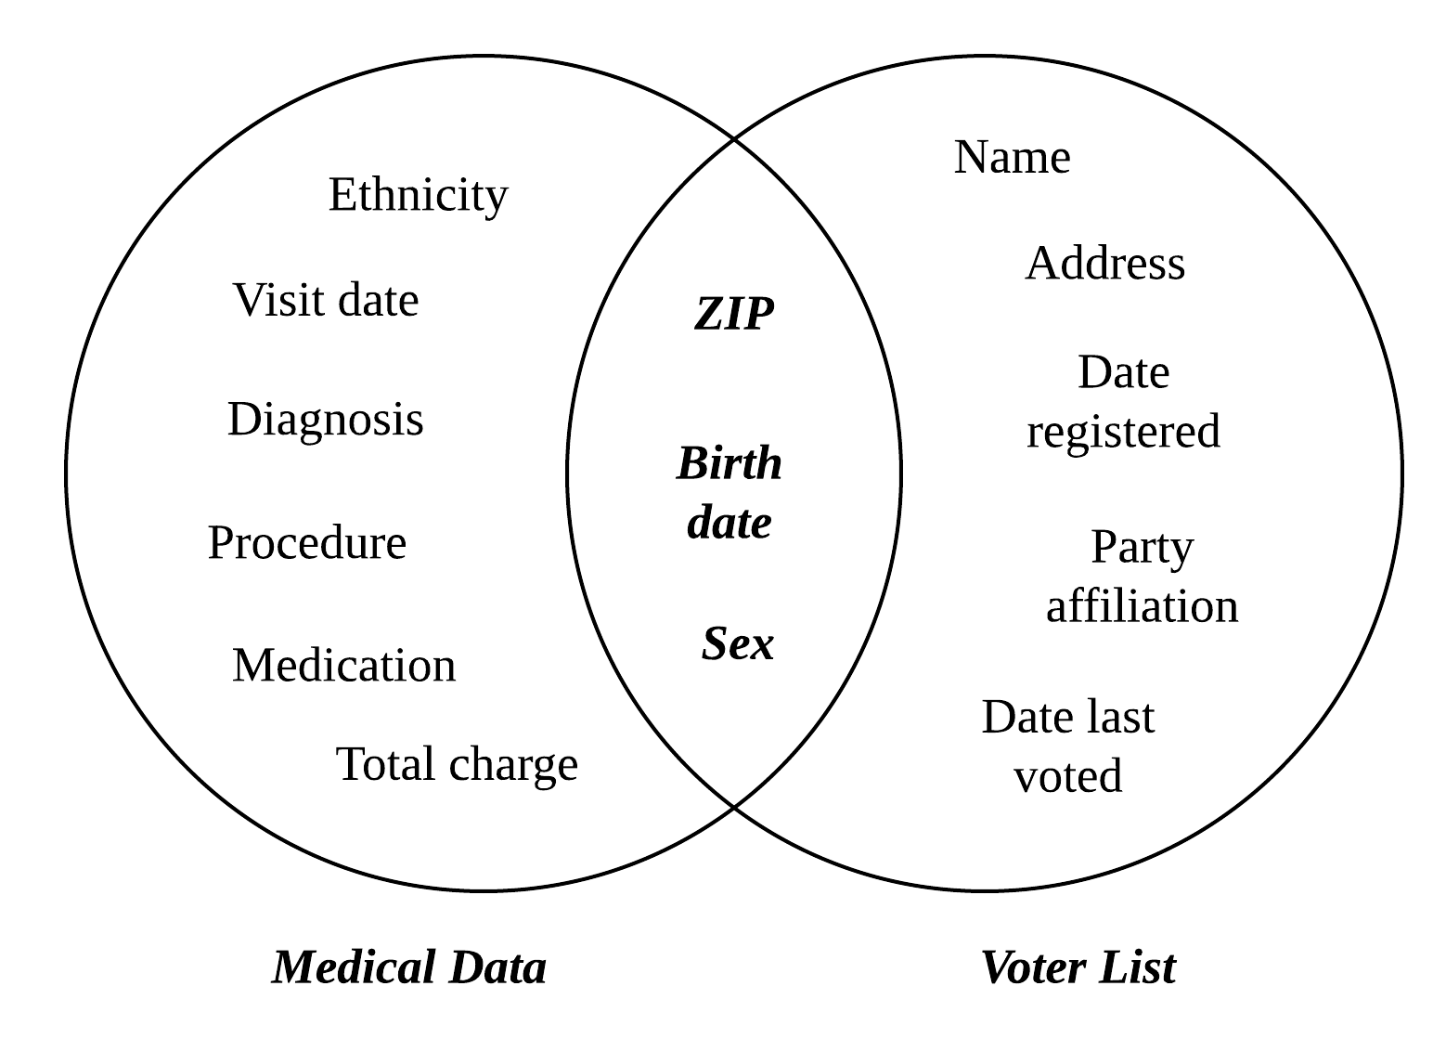
Introduction to Linkage
Linkage: when an adversary finds two datasets with sufficient common information about the same people that they can be merged.

Slide 3
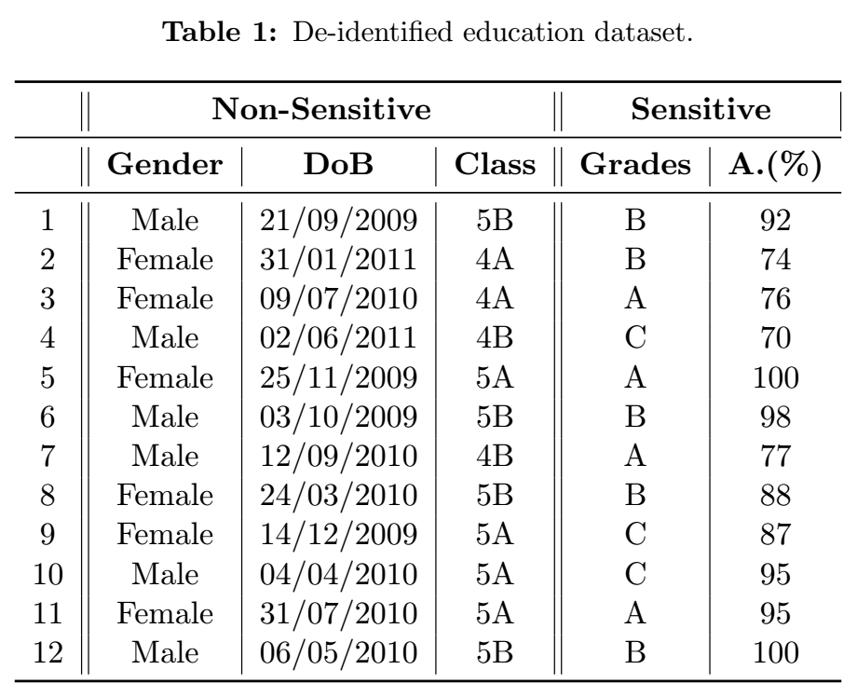
Measures of linkage
Re-identifiability: the potential by which the identities of people can be recovered by combining a supposedly anonymous dataset with another dataset.
Joinability: the potential by which datasets are linkable by unexpected join keys.

Slide 4
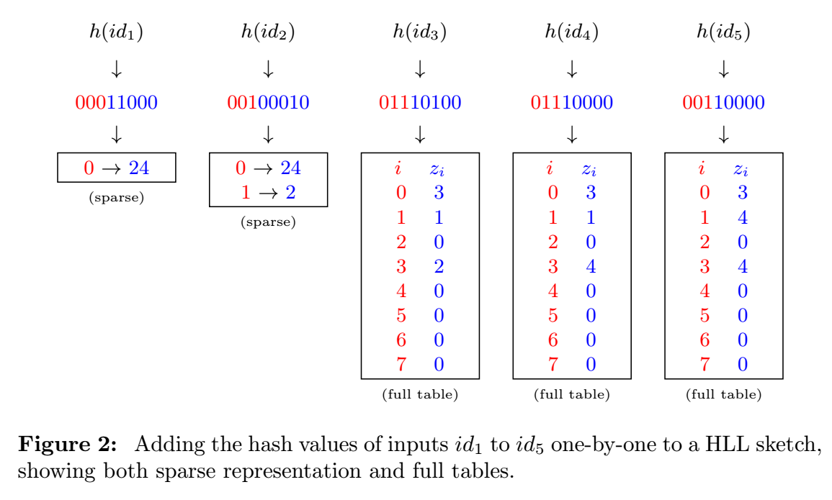
KHyperLogLog (KHLL)
HyperLogLog (HLL):
- Measure the uniqueness of all of the customer IDs associated with each movie
- Maximum number of trailing zeros
Low cardinality:
- Sparse representation

Slide 5
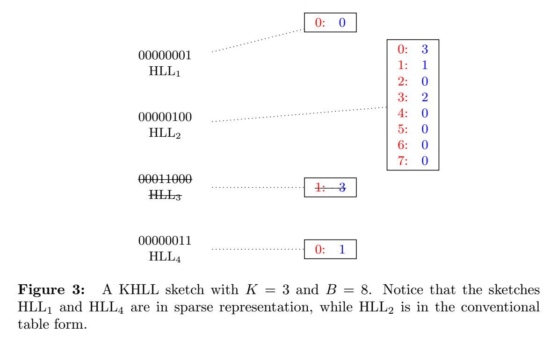
KHyperLogLog (KHLL)
K Minimum Values (KMV):
- Estimate the number of unique customer IDs associated with each movie
- Consider a representative sample of movies of size K
KHLL:
- Contains K HLL structures corresponding to the K smallest hashes of the movies

Slide 6
WRITING A PROGRAM FOR KHLL in python
Makes use of an existing Python package for HLL, extended it to write a program for KHLL
Large random dataset ~480k pairs based on Netflix prize dataset from 2006
User selects value of K, only consider those pairs where the movie has a hash value below K
Insert corresponding customer IDs into the HLL algorithm to acquire an estimate for their cardinality
Total cardinality estimate is the sum of the HLL lengths

Slide 7
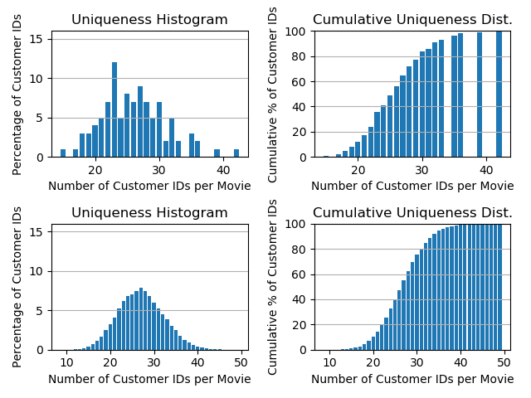
Uniqueness Distribution
Plot uniqueness distribution of the dataset after implementing KHLL (top)
Compare with uniqueness distribution of original dataset (bottom)
Example in diagram is when K=100. I also investigated K=10 and K=1000.

Slide 8
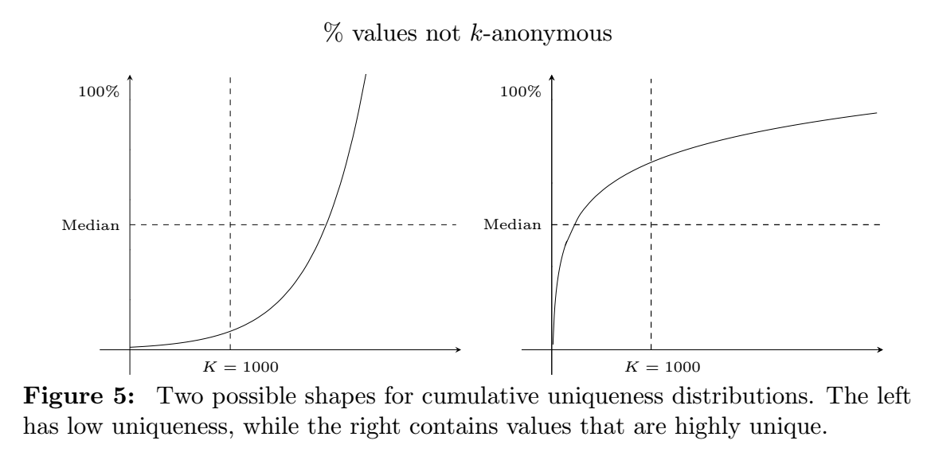
Re-identifiability Analysis
Quantify linkage risks:
- Re-identifiability by Uniqueness
- Joinability by Containment
Cumulative Uniqueness Distributions:
- Estimates how much data will be lost when applying a k-anonymity threshold

Slide 9
joinability Analysis
Quantify linkage risks:
- Re-identifiability by Uniqueness
- Joinability by Containment
Containment:
- Close to 0 indicates low risk of linkage
- Close to 1 indicates high risk of linkage
After KMV has been implemented, find the union of each pair of HLL algorithms
A cardinality estimate for their intersection is calculated using the inclusion-exclusion principle
Find the sum of all K of these cardinalities
Containment is estimated by dividing by the estimated cardinality of the relevant dataset
My dataset suggested a low containment which is what I expected given the small overlap

Slide 10
What I changed: cardinality estimates
I adopted a different method of estimating the cardinality from the one suggested in literature.
Instead of taking the maximum HLL length and dividing by K to estimate the density, I simply added up all of the HLL lengths.
The new cardinality estimate was significantly closer to the true value: on average, the percentage error was below 2% as opposed to over 10%.
Next step: find a way to scalably measure linkage risk from an arbitrary combination of columns.

Slide 11

Thank you for listening
Any questions?

